Slide 1
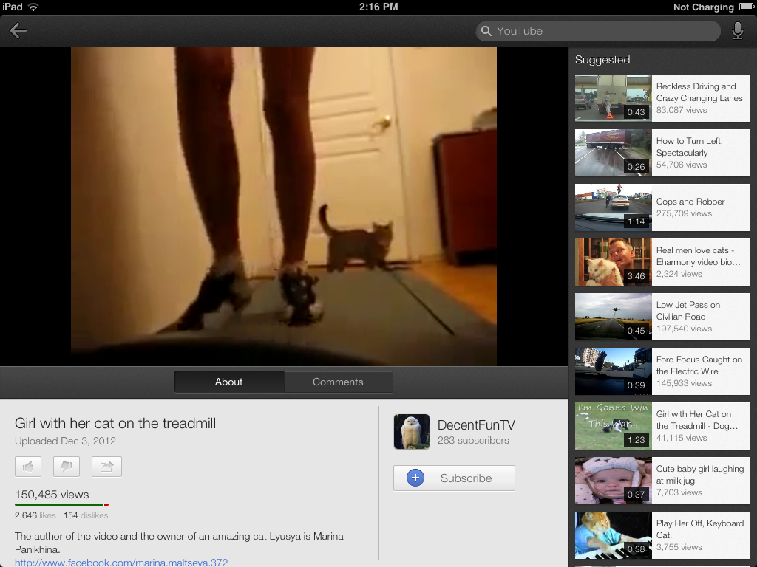

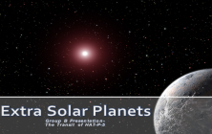

Planetary transit-Group B
NO INTELLIGENT LIFE
BUZZ
Not Many subscribers
Buzz gets the idea
http://www.facebookk.com/buzz

Slide 2


Group B – ExtraSolar Planets
Group B
999,000,000 subscribers
The best video of all time here, all about planetary transit!!! Made by Group B so unlucky!
http://www.facebookk.com/GroupB(thewinner)

Slide 3
Extra Solar Planets
Group B Presentation- The Transit of HAT-P-5

Slide 4
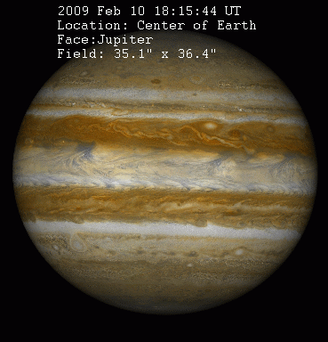
Planetary Transit
In astronomy, the term transit has three meanings. In this case it is the astronomical event that occurs when one entity appears to move across the face of another, hiding a small part of it, as seen by an observer from a particular vantage point. If the first entity
hides a major part, or all of,
the second entity, then
it is an occultation
rather than a transit.
Group B Presentation-Transit of HAT-P-5

Slide 5
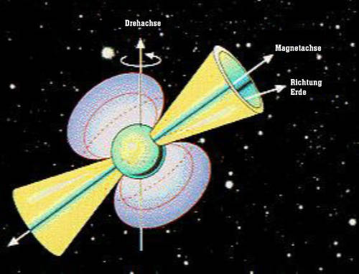
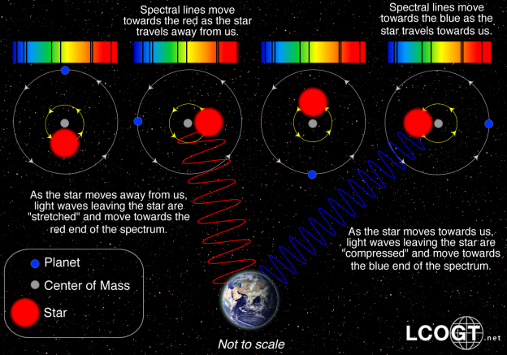
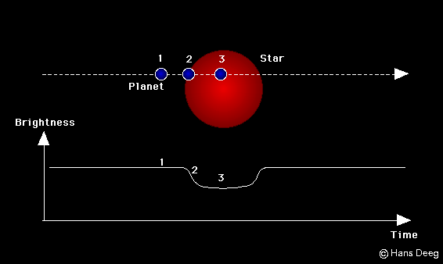
Methods of Detecting Planets
There is a multitude of methods that are used to detect extrasolar planets, a few of which, as shown below, I will briefly describe:
Pulsar timing
Radial velocity
Transit Method
For further information on more methods or further description on those provided you can visit –
http://en.wikipedia.org/wiki/Methods_of_detecting_extrasolar_planets
Group B Presentation-Transit of HAT- P-5
Notes:
Radial velocity
A star with a planet will move in its own small orbit in response to the planet's gravity. This leads to variations in the speed with which the star moves toward or away from Earth, i.e. the variations are in the radial velocity of the star with respect to Earth. The radial velocity can be deduced from the displacement in the parent star's spectral lines due to the Doppler effect. The radial-velocity method measures these variations in order to confirm the presence of the planet. The radial-velocity method has been by far the most productive technique used by planet hunters. It is also known as Doppler spectroscopy. The method is distance independent, but requires high signal-to-noise ratios to achieve high precision, and so is generally only used for relatively nearby stars out to about 160 light-years from Earth. It easily finds massive planets that are close to stars. Modern spectrographs can also easily detect Jupiter-mass planets orbiting 10 astronomical units away from the parent star but detection of those planets requires many years of observation.
Pulsar timing
A pulsar is the small, ultradense remnant of a star that has exploded as a supernova. They emit radio waves extremely regularly as they rotate, These can be tracked to determine the motion of the Star. Like an ordinary star, a pulsar will move in its own small orbit if it has a planet. Calculations based on pulse-timing observations can then reveal the parameters of that orbit. This method was not originally designed for the detection of planets, but is so sensitive that it is capable of detecting planets far smaller than any other method can, down to less than a tenth the mass of Earth. The main drawback of the pulsar-timing method is that pulsars are relatively rare so it is unlikely that a large number of planets will be found this way.
Transit Method
The transit method is based on the observation of a star's small drop in brightness, that occurs when the orbit (dashed line) of one of the star's planets passes ('transits') in front of the star The amount of light lost -typically between 0.01% and 1%- depends on the sizes of the star and the planet; and the duration of the transit depends on the planet's distance from the star and the star's mass. Since the star's mass and size can be determined from spectroscopic observations, the planet's size and distance can be determined. Of course, a transit has to occur once for every orbital revolution of the planet around the star. This repeated occurrence of transits is the major diagnostic tool to determine if an observed transit is really from a planet - it has to appear once in each of the planet's 'year'.
The repeatability of transits gives also the opportunity to observe a known transiting planet in the future with improved instrumentation - one day it may be possible to examine a planet's atmosphere (by spectroscopy of absorption lines from its atmosphere while it is transiting) and check it for indicators of life - such as the presence of free oxygen in the atmosphere.

Slide 6
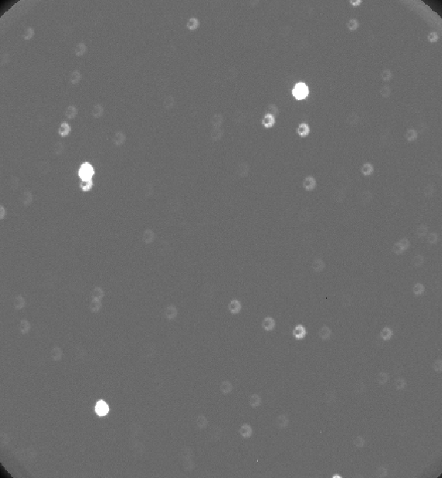
HAT-P-5
C1
C2
Star Data:
Type: G
Mass: 1.16 (+- 0.062) Solar Masses
Radius: 1.167 (+- 0.049) Solar Radii
Age: 2.6 (+-1.8) Giga Years (Estimated)
Coordinates: Ra 18h 17m 51.8s
δ +36˚ 37’ 25.01”
Planet Data:
Orbital Period: 2.7884491 (+- 0.000025) days
Transit Duration: 0.1217 (+- 0.0012) days
Mass: 1.06 Jupiter Masses
Radius 1.26 Jupiter Radii
Surface Temperature: ~1500 Kelvin
HAT-P-5
More information about HAT-P-5 is included in the report and you can find out any extra information about HAT-P-5 or HAT-P-5b at http://en.wikipedia.org/wiki/HAT-P-5 and http://en.wikipedia.org/wiki/HAT-P-5b
Group B Presentation-Transit of HAT-P-5
Notes:
HAT-P-5 is a star alike to our on sun in sharing the same classification, type G which is situated 340 (± 30) parsecs away. Observations from the HAT Net transit search programmes lead to arising suspicion of the potential orbiting of a transiting planet around this host star; a hypothesis which was later verified by spectroscopic observations. The planet causing the transit that we have been observing and analysing is called HAT-P-5b and was discovered on 9th October 2007.

Slide 7
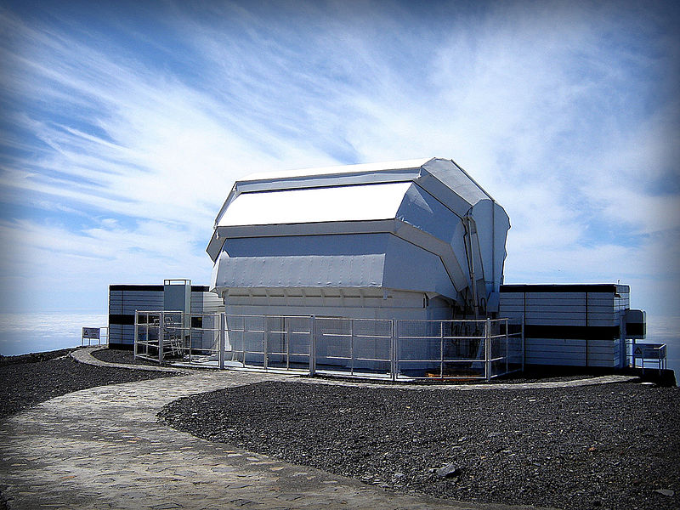
Liverpool Telescope
Organisation: Liverpool John Moores University
Location:Observatorio del Roque de Los Muchachos,
La Palma
Coordinates:28.76234°N 17.87925°W
Altitude:2363 m
Website: http://telescope.livjm.ac.uk/
Basic Information:
The Liverpool Telescope is a 2-metre (6.6 ft) fully robotic telescope that observes /operates without human intervention.
It is the largest robotic telescope in the world to be used primarily for astronomical research.
The Telescope has a rapid-response capability where it can automatically interrupt regular observations to observe momentary phenomena with higher priority, such as gamma-ray bursts.
Group B Presentation-Transit of HAT-P-5

Slide 8
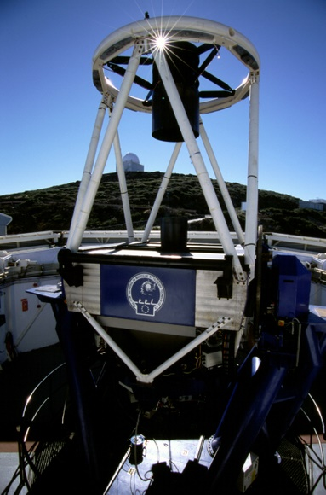
RiSE Instrument
RiSE is a fast-readout camera designed and manufactured in the collaboration of a variety of people/places (Including mechanical design work being done at Liverpool John Moores). It was created for the precision measurement of transiting exoplanet timing.
Key Features:
Pixel Scale: 0.54 arcsec/pixel
Field of view 9.2 x 9.2 arcmin (11 arcmin unvignetted circle)
No readout overhead.
Minimum exposure Time 1.5 seconds (1x1 binning) or 0.8 seconds (2x2 binning)
Saturation Limit 20,000 counts(1x1 binning) or 40,000 counts(2x2 binning)
Gain (2x2 binning) 2.3 electrons/count
Read noise (2x2 binning) 10 electrons
Mean dark current (2x2 binning) 0.0143 counts/sec
For a full specification and more info you can visit: http://telescope.livjm.ac.uk/Info/TelInst/Inst/RISE/
Group B Presentation-Transit of HAT-P-5

Slide 9
Results
Key;
HAT-P-5
C1
C2
In our investigation we measured the brightness of three stars, these stars are shown below when HAT-P-5 was at its brightest and dimmest points during the night:
Brightest ,23:25:22
Dimmest, , 01:25:48
Group B Presentation-Transit of HAT-P-5

Slide 10
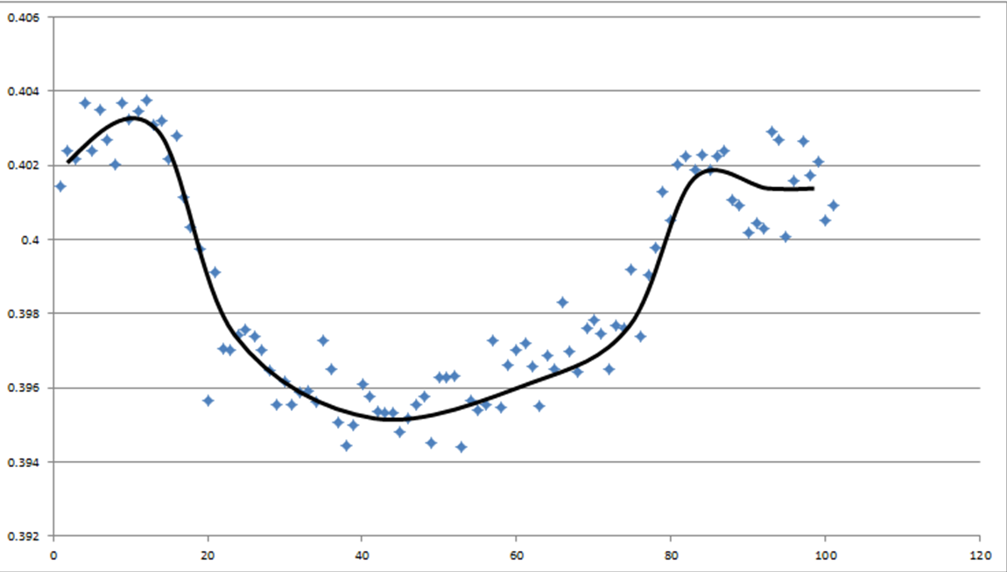
Results
Relative brightness (S/C1)
Image number
Notes:
This graph displays the variation in brightness of the star HAT-P-5 over the course of the 4.5 hours that it was monitored. The variation was slight; the star, at most, only dimmed by 1.03% during the time it was monitored. From the results of our research into the topic that took, we managed to deduce that
although the change in luminosity was very slight, in comparison to the other stars (referred to as C1 and C2),it is characteristic of an extra solar planetary transit.
Using the measurements of brightness from LTimage along with known data about the host star HAT-P-5, we were able to calculate the radius of
the planet orbiting it with an accuracy of 92.6%.We calculated the
planet radius to be 8.17x10⁷m (=0.1167 solar radii); with a high degree
of accuracy in comparison to the approximate suggested radius of
the planet is 0.126 solar radii.

Slide 11
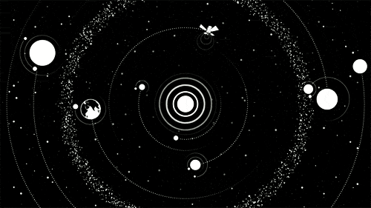
THANKYOU!
Group B – YOUR WINNERS.

